Slide 2
Church online website system
the numbers are the tabs of the website/what you can see on the nav bar.
then under that (-) is the sub-bars (i don't know the term haha)
and the succeeding are just the flow of what may appear when it was clicked or next.
1. REGISTER (registration for side)
2. LOG IN (member side)
3. HOME
4. ABOUT

Slide 3
5. EVENTS
-Attend Service
-COVID-19 Contact Tracing Form (the user cannot book anymore if he/she stated yes in any questions in contact tracin form. this is for safety purposes)
-redirect to service type (1st Service Sunday, 2nd Service Sunday, Midweek Bible Study(wednesday), service date (every sunday and wed only, it would appear when clicked like a calendar widget in which sunday and wed are only clickable )
note: booking is only for the registered user so one is to one only. once the quota for a service is met, the user cannot book anymore. And will be shown an "attention box" stating she/he cannot book already. Try other schedule or service.
-seat selection (50 seats capacity for congregation/members then 20 for the church workers/pastor etc., same as your cinema seat booking, where the user can select unoccupied seats and see what seats are booked already, it has symbols for who will seat there, color coding: P for pastor (grey box), CW for church workers (grey box), blue colored box for congregations (unoccupied), red for occupied, it has js that when hovered, color will change.
-after reservation, “thank you for registering for (service type, day, date,seat number for example: 1st Sunday Service, Sunday, May 30, 2021, A5 ). please print or take a screenshot of this so you can have a hard copy of the reservation. model 6?
-a confirmation has been sent to (email)” (if qr code is possible it is much welcome but im afraid if i can explain it to my professor hehe, or maybe payment may go up higher)
what he/she may see in email is the service summary, service date, full name, seat number
after that, under events page, he/she will saw this
-your booked events
(in which he/she can cancel, edit) model 8

Slide 4
6. CONTACT US
7. MY ACCOUNT (MEMBER)
-prayer requests model 9(only user and the admin can see this)
-about
-message
-submit
-testimonials model 10 (all users will see this)
-about
-message
-submit
-donate model 11
-gift amount
-payment method
-GCASH
-Bank to bank
-Paymaya
-upload photo of reference number
-pay now
redirect to “Thank you for your donation. Please wait for the email of our customer service once the transaction was verified. God Bless”

Slide 5
WEBSITE DESIGN
THEME COLOR: ROYAL BLUE/WHITE/GRAY
FONT: ROBOTO SANS SERIF
WEBSITE DESIGN LOOKS LIKE THIS AND THE NAVIGATION BAR
https://jilworldwide.org/

Slide 6
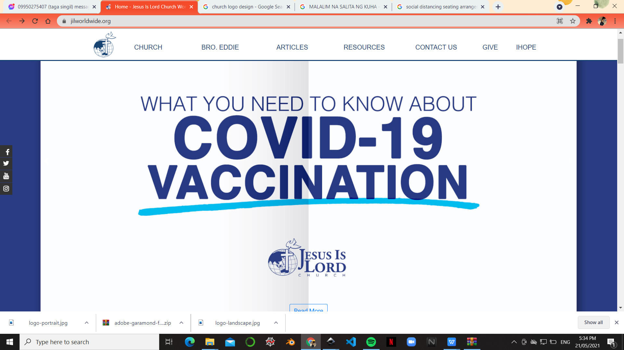

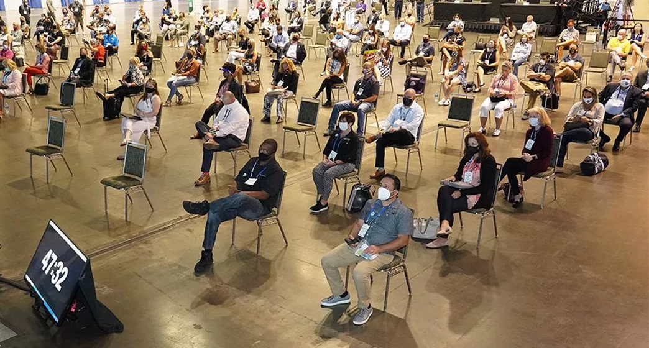

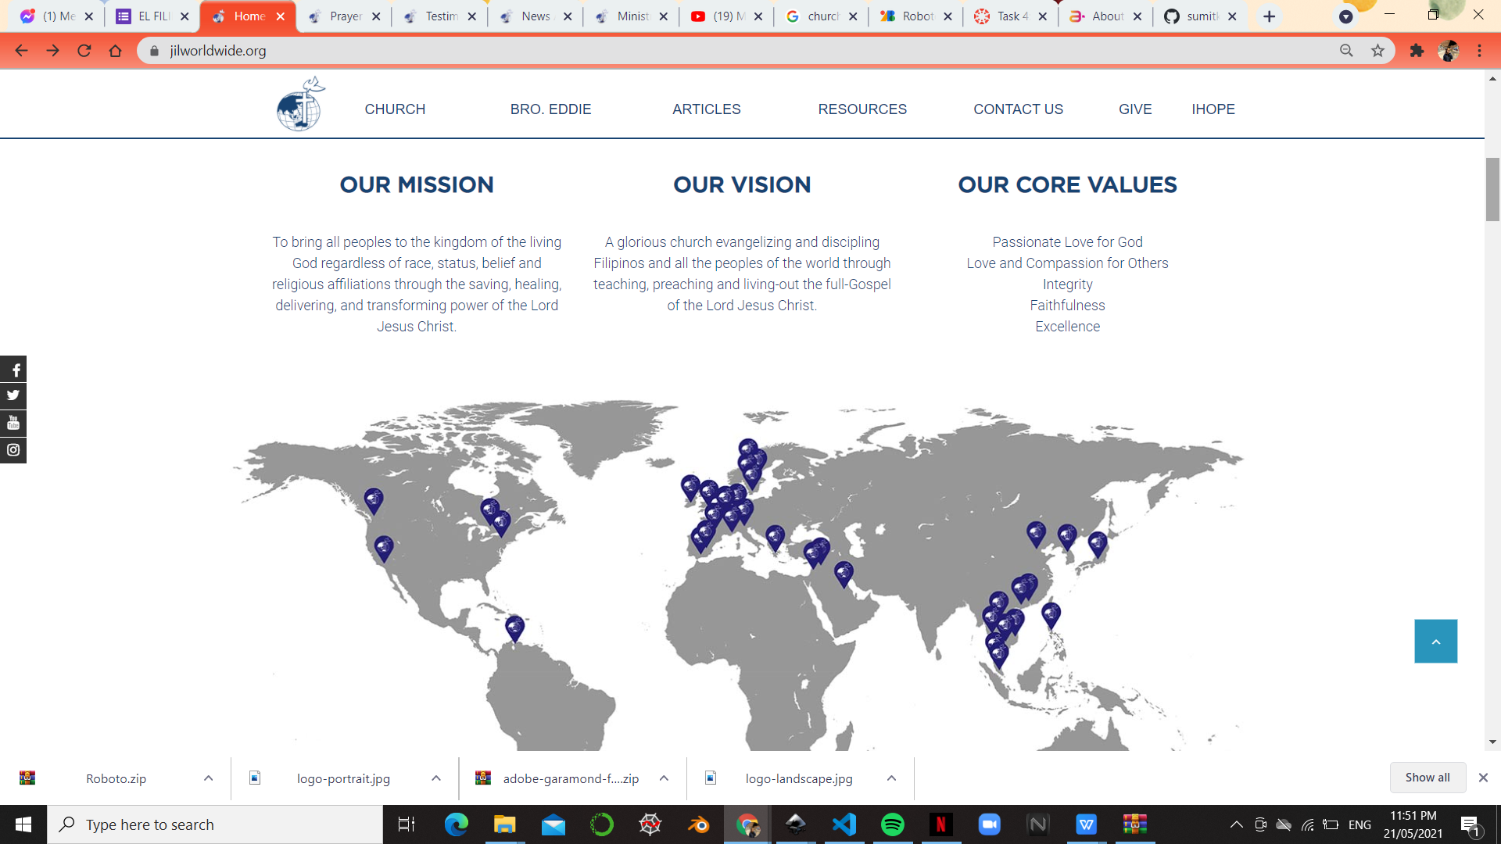
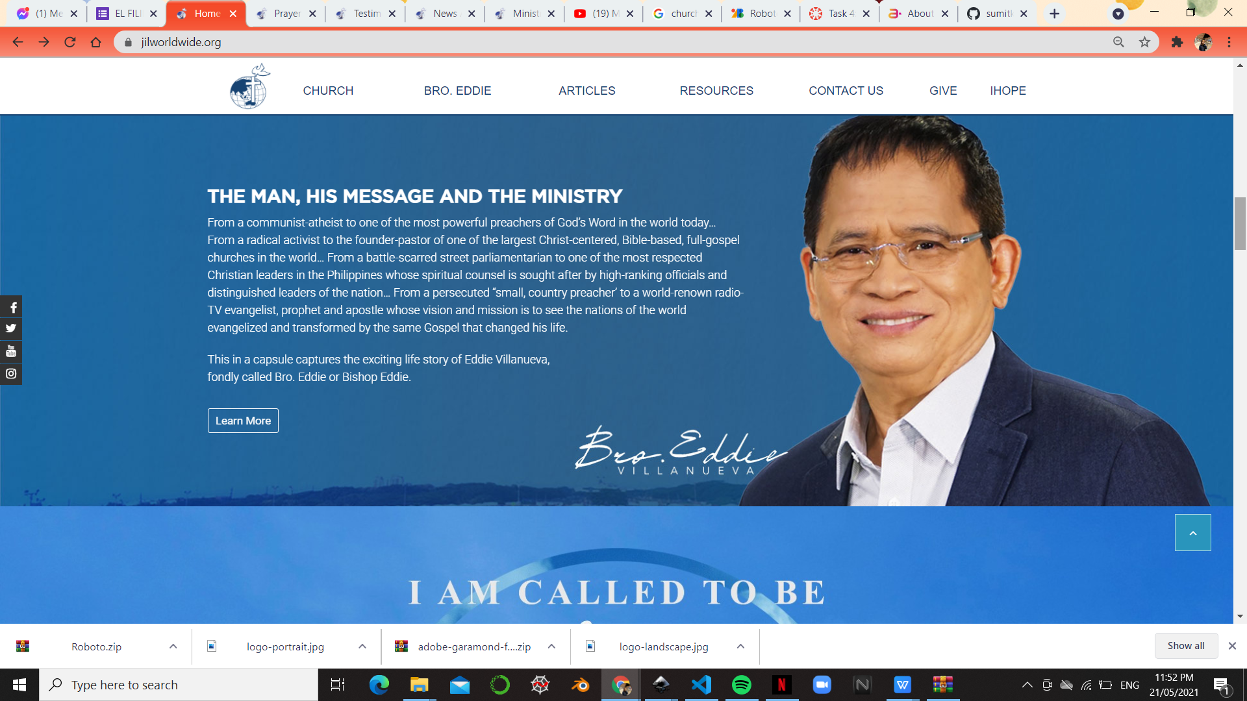
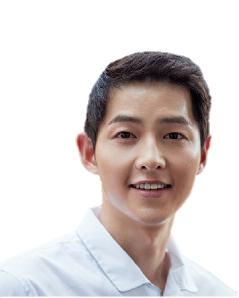
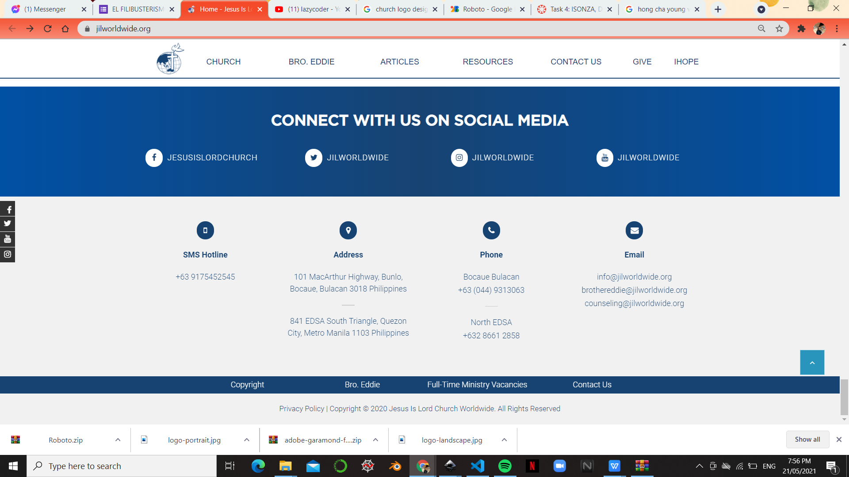
ABOUT
CONTACT US
MEMBER
ADMIN
HOME
REGISTER
<----HOME
(SLIDER)
<
>
<----ABOUT
Bro. Vincenzo Gracilla
<----CONTACT US

Slide 7
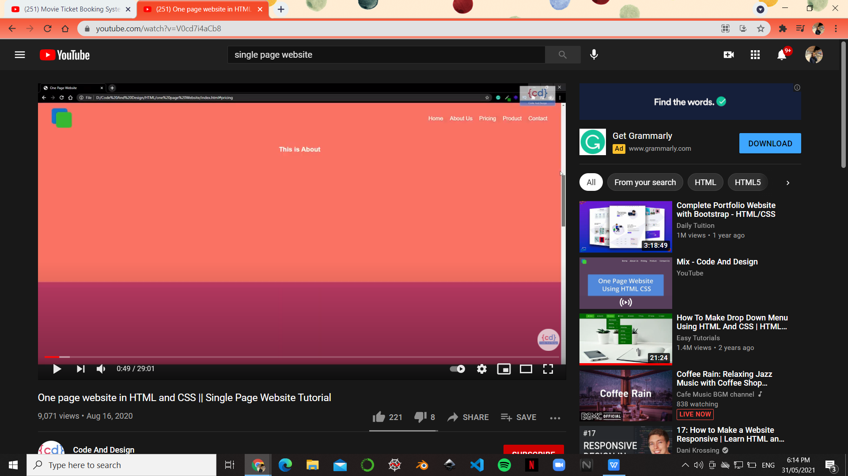
SINGLE OR ONE PAGE WEBSITE VIDEO EXAMPLE https://www.youtube.com/watch?v=V0cd7i4aCb8

Slide 8
#1 NAV BAR (NOT LOG IN/NO ACC IS ONE PAGE ONLY)
the boxes are dropdown menuuu in each elements in navbar
ABOUT
EVENTS
CONTACT US
MEMBER
ADMIN
HOME
REGISTER
> Attend Service
> LOG IN
> CREATE ACCOUNT
> LOG IN

Slide 9
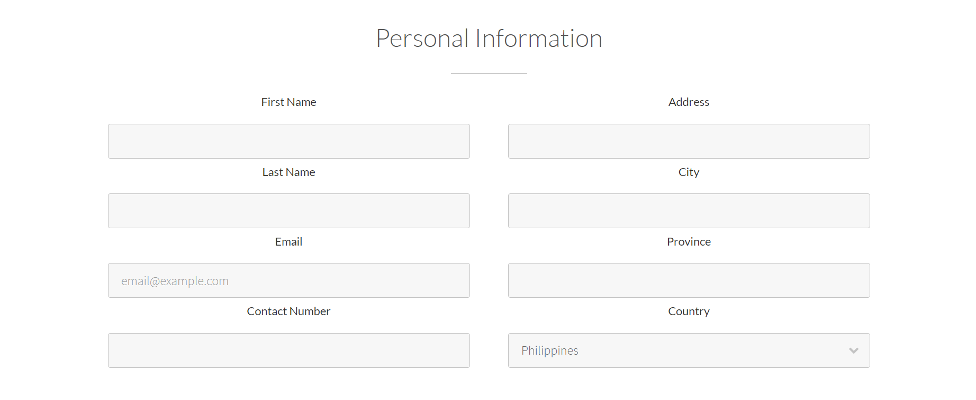
Member Create Account
CREATE YOUR ACCOUNT
Full Name
Contact Number
Email
Birthday
Sex
Upload Account Photo
Male
Female
Enter Desired Password
Re-enter your password
SUBMIT

Slide 10
Member Log in
MEMBER LOG IN
Enter Email/Contact number
Enter Password
SUBMIT
Notes:
i dont know if i’ll add forgot password here hmmmmm

Slide 11
Admin Log in (Email for this is the hisgracechurch@gmail.com password is 1234567890 )
ADMIN LOG IN
Email
Enter Password
SUBMIT

Slide 12
HOME PAGE
SLIDER 1

Slide 13
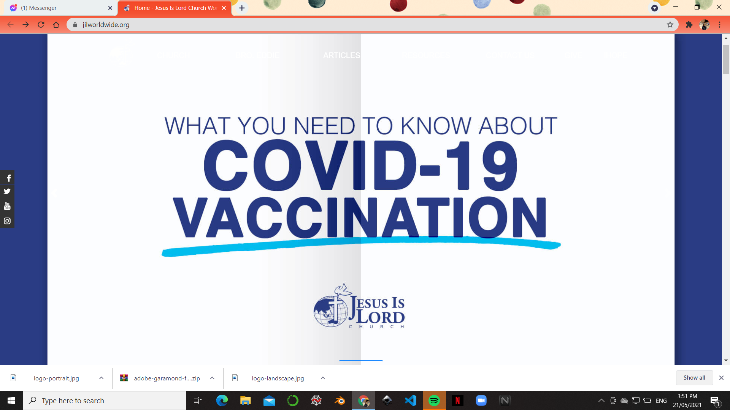
HOME PAGE
SLIDER 2
JOIN US IN WORSHIP
RESERVE YOUR SEATS NOW!

Slide 14
HOME PAGE
SLIDER 3
NOT YET A MEMBER?
REGISTER
TODAY
SO YOU CAN BOOK SEATS IN F2F WORSHIP
You can still watch the service live on FB account at www.facebook.com/HisGraceChurch

Slide 15

HOME PAGE
SLIDER 4
OUR MOVEMENT TOWARDS EVANGELISM
REACH. PREACH.
REPEAT.

Slide 16
ABOUT

Slide 17
ABOUT
Bro. Vincenzo Gracilla
add this tooooo. after this^^^^^^
same as this but change the name :D into his grace church
https://jilworldwide.org/church/

Slide 18
CONTACT US (IS ALSO THE FOOTER, IT WILL JUST GO DOWN OR REDIRECT TO THE FOOTER WHEN CLICKED IN EVERY PAGE OF THE WEBSITE)

Slide 19
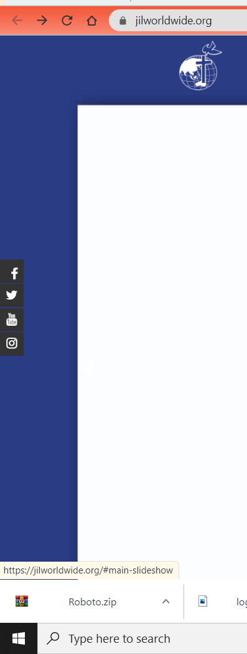
FOOTER AND SIDE NAVIGATION BAR/SOCMED
HIS GRACE CHURCH
HISGRACECHURCH
HISGRACECHURCH
HISGRACECHURCH
Area F, Congressional HIghway,
Dasmarinas City, Cavite, 4115 Philippines
Dasmarinas City Cavite
info@hisgracechurch.org
counseling@hisgracechurch.org
Privacy Policy | Copyright c 2021 His Grace Church. All Rights Reserved

Slide 20
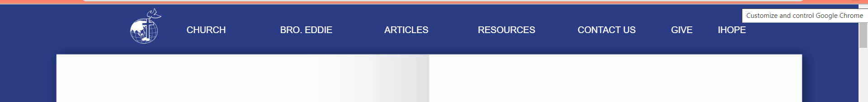
#2 NAV BAR (MEMBER LOG IN ALREADY)
HOME
ABOUT
EVENTS
CONTACT US
MY ACCOUNT
HOME
ABOUT
EVENTS
CONTACT US
MY ACCOUNT
> Attend Service
>My Booked Events
>Edit Profile
>Send Message
>Give Support
>Log out
<---DROPDOWN
Notes:
my account there is

Slide 21
SEND MESSAGE
SEND MESSAGE
Message Type
Prayer Request
Testimony
Date
dd/mm/yyyy
Title
Message
SUBMIT
SUBMIT

Slide 22
GIVE SUPPORT
same as this but the content is slightly different, no select gift and personal info (because the website will use the logged in account info)
https://jilworldwide.org/donate/
BANK DETAILS
BPI 9774620010
HIS GRACE CHURCH
-gift amount
-payment method
-GCASH
-Bank to bank
-Paymaya
-upload photo of reference number
-pay now
redirect to “Thank you for your donation. Please wait for the email of our customer service once the transaction was verified. God Bless”

Slide 23
Give, and you shall
Receive
“Give, and it will be given to you. A good measure, pressed down, shaken together and running over, will be poured into your lap.
For with the measure you use, it will be measured to you.”
Luke 6:38 NIV
Gift Amount
Payment Details
Bank of the Philippine Islands
MacArthur Highway, Tabing Ilog, Marilao, Bulacan Branch
Zip Code 3019
Account Name: His Grace Church
Current Account No.:
0643-1276-87
Swift Code: BOPIPHMM
Payment Method
Gcash
Bank Transfer
Upload Photo of Reference Number
file upload
PAY NOW

Slide 24
EVENTS page
COVID CONTACT TRACING FORM>BOOKING PAGE(W/SEAT RESERVATION>REDIRECT TO MY BOOKED EVENTS

Slide 25
5. EVENTS
-Attend Service
-COVID-19 Contact Tracing Form (the user cannot book anymore if he/she stated yes in any questions in contact tracin form. this is for safety purposes)
-redirect to service type (1st Service Sunday, 2nd Service Sunday, Midweek Bible Study(wednesday), service date (every sunday and wed only, it would appear when clicked like a calendar widget in which sunday and wed are only clickable )
note: booking is only for the registered user so one is to one only. once the quota for a service is met, the user cannot book anymore. And will be shown an "attention box" stating she/he cannot book already. Try other schedule or service.
-seat selection (50 seats capacity for congregation/members then 20 for the church workers/pastor etc., same as your cinema seat booking, where the user can select unoccupied seats and see what seats are booked already, it has symbols for who will seat there, color coding: P for pastor (grey box), CW for church workers (grey box), blue colored box for congregations (unoccupied), red for occupied, it has js that when hovered, color will change.
-after reservation, “thank you for registering for (service type, day, date,seat number for example: 1st Sunday Service, Sunday, May 30, 2021, A5 ). please print or take a screenshot of this so you can have a hard copy of the reservation. model 6?
-a confirmation has been sent to (email)” (if qr code is possible it is much welcome but im afraid if i can explain it to my professor hehe, or maybe payment may go up higher)
what he/she may see in email is the service summary, service date, full name, seat number
after that, under events page, he/she will saw this
-your booked events
(in which he/she can cancel, edit) model 8

Slide 26
COVID-19 CONTACT TRACING FORM
COVID-19 CONTACT TRACING FORM
Please answer with all honesty for the safety of the entire attendees
*Required
Did you interacted with someone who has been confirmed with COVID-19?
Yes No
Did you had a fever, cough, cold, or sore throat in the past 2 weeks?
Yes No
Have you traveled outside the Philippines in the past 14 days?
Yes No
Have you ever been to an area with a high Covid-19 case count?
Yes No
Select any symptoms you currently have:
No symptoms
Cough
Fever
Headache
Heavy Breathing
Sore Throat
Diarrhea
Loss of Taste/Smell
Rash on Skin
Discolouration of Fingers/Toes
I authorize JIL Church Dasma-Main to retrieve and process the details I have provided herein in relation to the existing COVID-19 control protocol. I understand that my personal information is protected by law under the Data Privacy Act. I certify that all information provided in this form is correct and true.
BACK
NEXT
Notes:
-COVID-19 Contact Tracing Form (the user cannot book anymore if he/she stated yes in any questions in contact tracin form. this is for safety purposes)

Slide 27
Redirect to Html (if the member select even ONE YES in COVID form)
Sorry but you are not allowed to reserve seat in F2F Church Service.
Stay Safe and keep yourself healthy.
You are welcome to watch via live streaming on our Facebook Page.
God Bless!

Slide 28
BOOKING PAGE
F2F CHURCH SERVICE SEAT SELECTION
Please fill up the required details and choice your desired seat
Dropdown box
1st sunday service
2nd sunday service
Midweek Bible Study ---------->
Service Type
Service Date
1st Sunday Service
dd/mm/yyyy
PROCEED SELECTING
Please select your desired seat
Pastor seat
Occupied
Worker seat
Occupied
Member seat
Occupied
P
Empty Seat
P
W
W
STAGE
1 2 3 4 5 6 7 8 9 10
A
B
C
D
E
F
G
H
I
J
P
P
W
W
W
W
W
W
W
W
W
W
W
W
W
W
W
W
W
W
CONFIRM SELECTION
NAME | SEAT CODE
BACK
NEXT
Notes:
-seat selection (50 seats capacity for congregation/members then 20 for the church workers/pastor etc., same as your cinema seat booking, where the user can select unoccupied seats and see what seats are booked already, it has symbols for who will seat there, color coding: P for pastor (red box), CW for church workers (yellow box), blue colored box for congregations (unoccupied), red for occupied, it has js that when hovered, color will change.

Slide 29
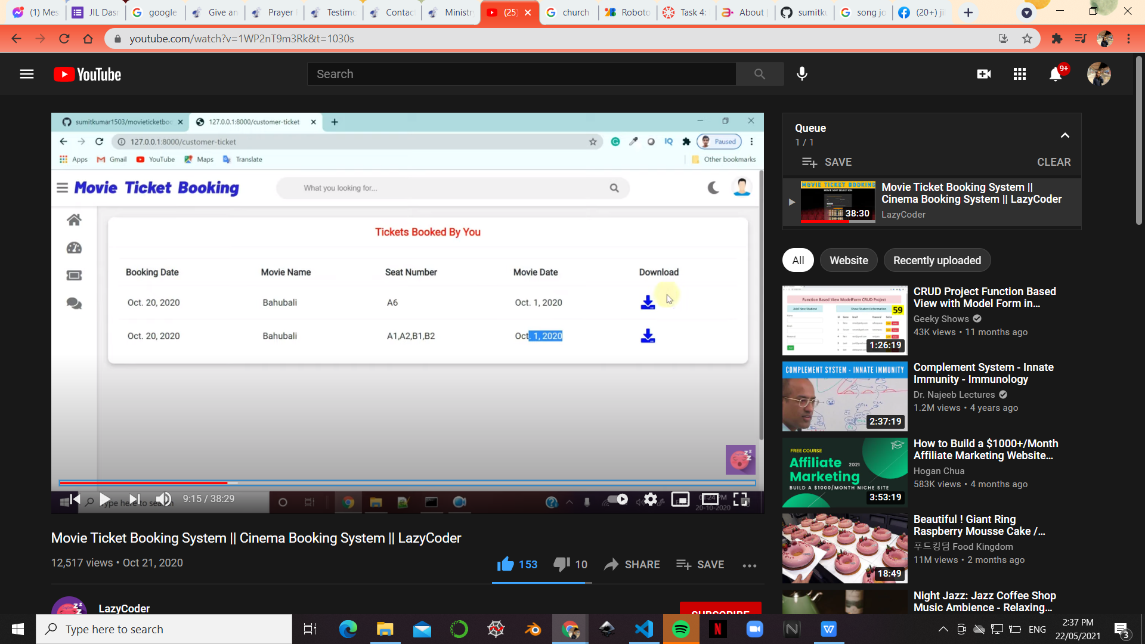
MY BOOKED EVENTS(like this)

Slide 30
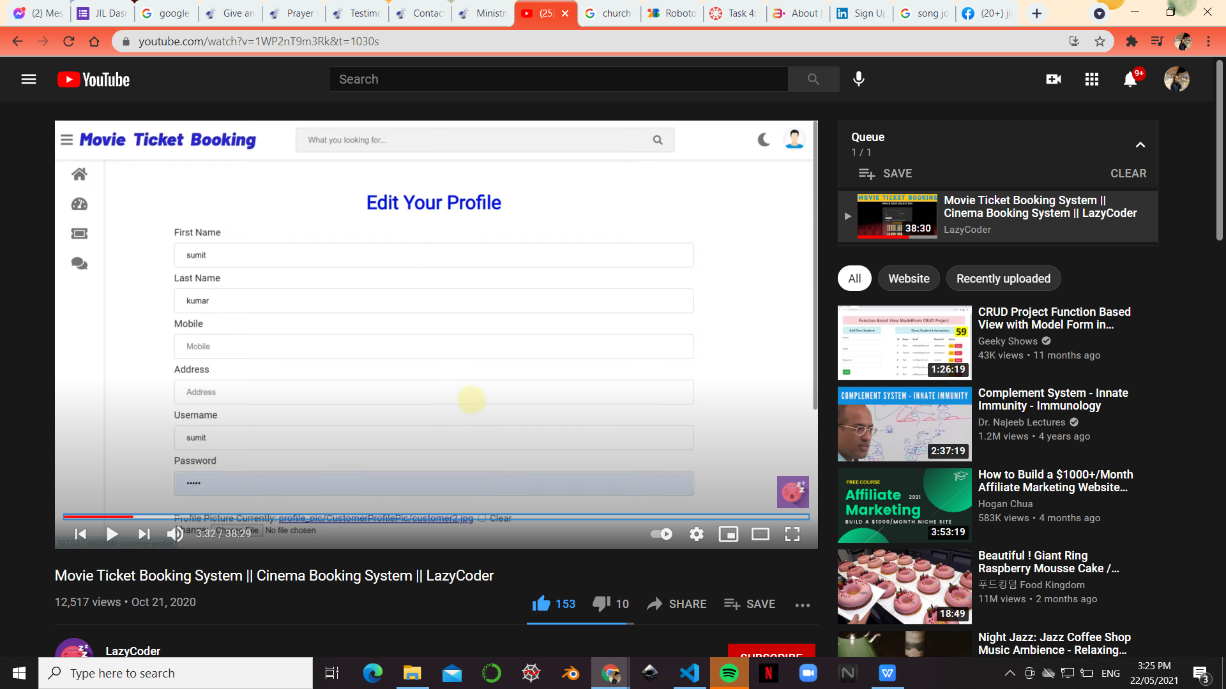
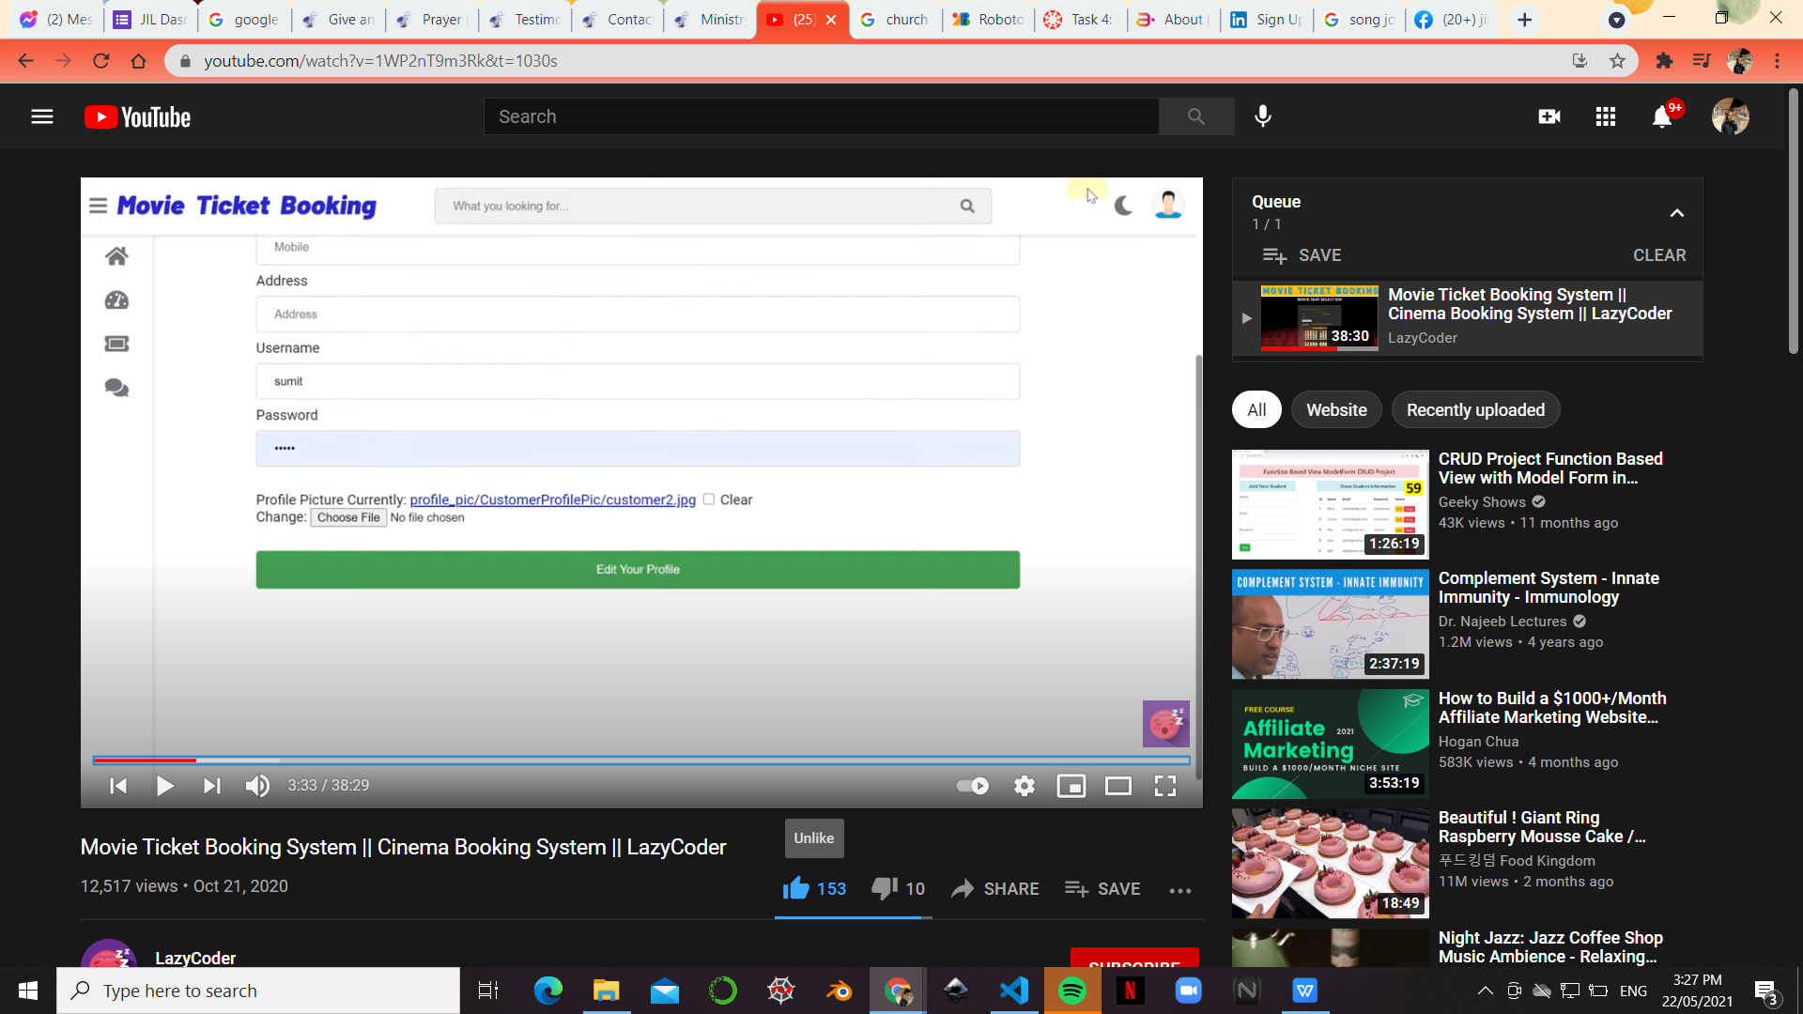
EDIT PROFILE

Slide 31
#2 NAV BAR (ADMIN LOG IN ALREADY, SINGLE PAGE) the view messages is where THE ADMIN can see the user sent prayer request and testimony
WHEN STATIC/ LOGGED IN AND WITH ACC
HOME
ABOUT
EVENTS
CONTACT US
MY ACCOUNT
> View Messages
WHEN SCROLLED
EVENTS
MESSAGES
NEWS
MY ACCOUNT
> View Booking
>Log out
WHEN CLICKED

Slide 32
how many models will this website have?
if i get 7 models for members side, do not include the NEWS/TESTIMONY in the navbar. as well as the admin side.
if i got less than that please include the admin side. if possible.
my prof wants us to use static folder for css/java/images if it is we will utilize a lot. the {{ }}
but if not, you may incorporate it inside the html file. is it also possible to put comment in parts of the code so i can understand what is it for?
also we are using ubuntuuuu. not windows. will the project work? i think you are using windows as OS.
THANK YOU!

